Slide 1
TallyPrime Release 4.1 e-Commerce changes in GSTR 1/3B & MSME feature

Slide 2
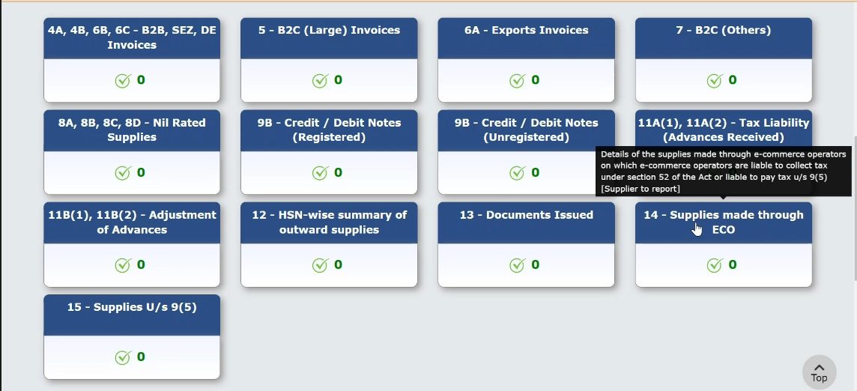
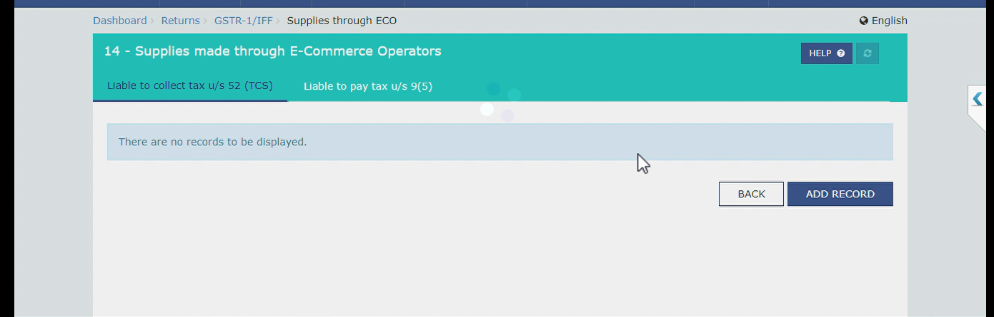
e-Commerce changes in GSTR 1/3B
In GSTR 1 –New Table 14 and 15 w.e.f 1st Jan24 for all sales & services made online through e-commerce platforms must report in Table 14 under Sec.14A & Sec 14B respectively by the supplier.
GSTR 1 Table 14 Drill down Table 14 with Sec.14A & Sec 14B

Slide 3
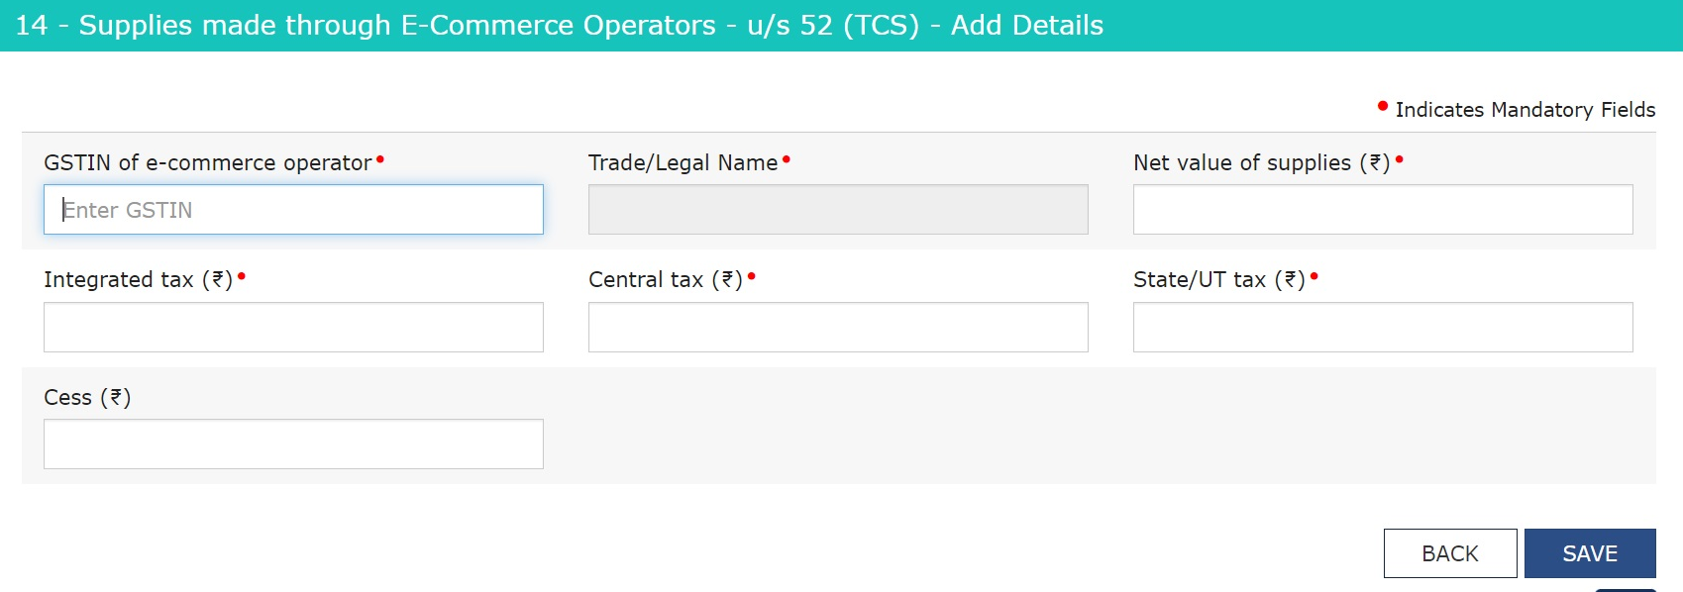
e-Commerce changes in GSTR 1/3B
Table 14 Sec. 14A: Business selling goods on e-commerce platforms like Amazon / Flipkart / Myntra / AJIO etc. to be reported by supplier

Slide 4
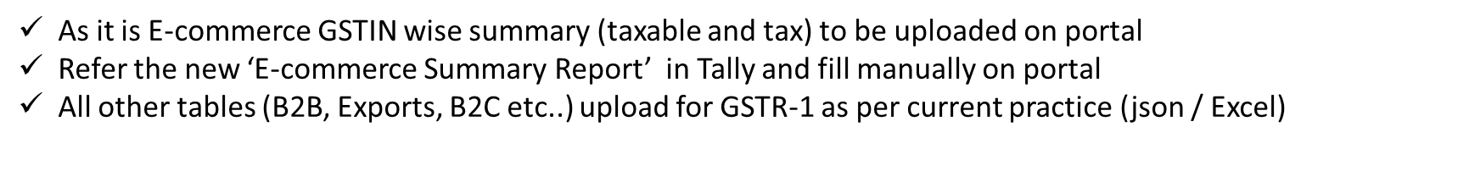
e-Commerce changes in GSTR 1/3B
Table 14 Sec. 14A Solution

Slide 5
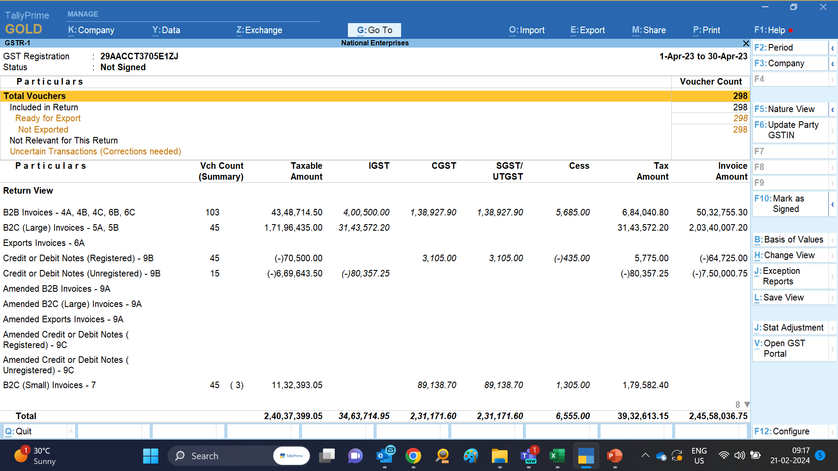

Slide 6
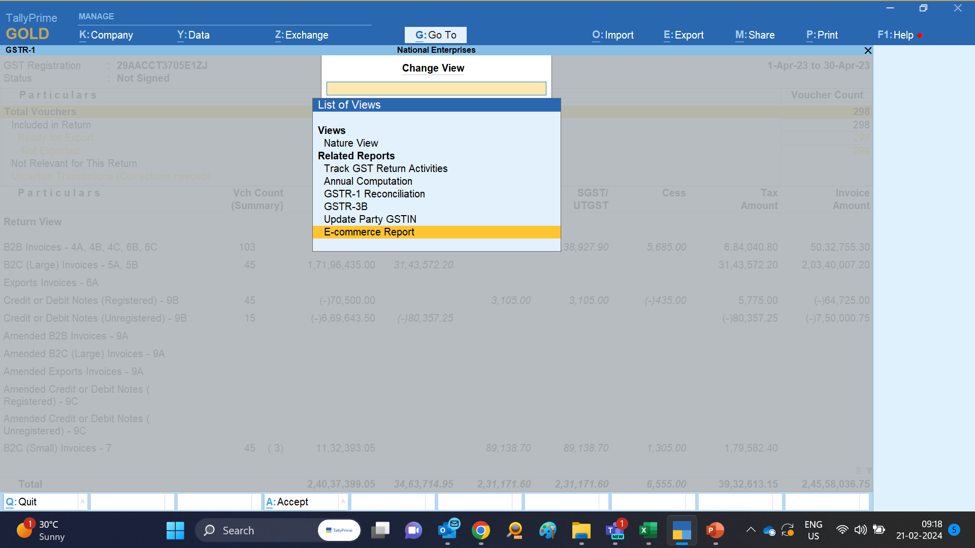

Slide 7
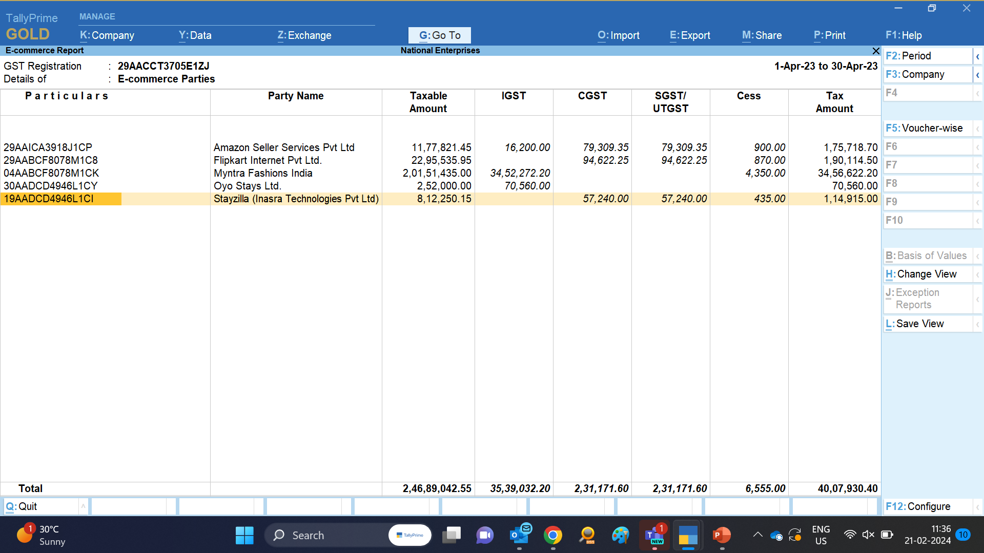

Slide 8
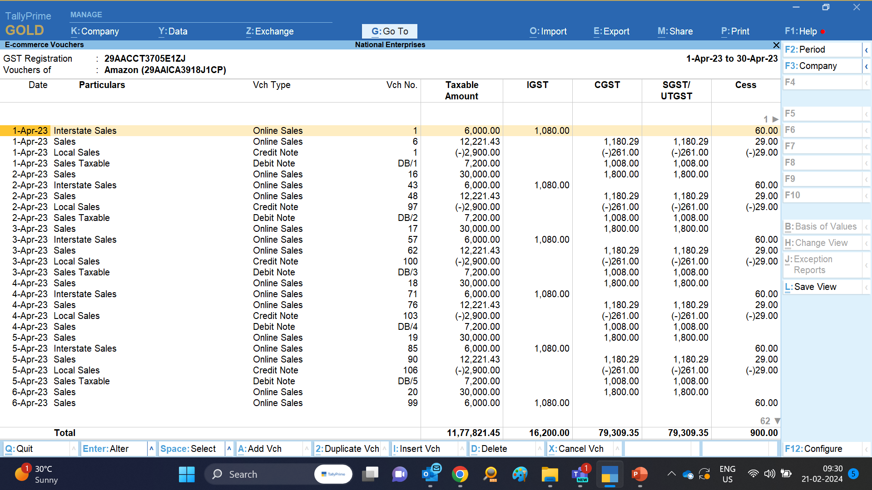
Amazon Seller Services Pvt Ltd (29AAICA3918J1CP)

Slide 9
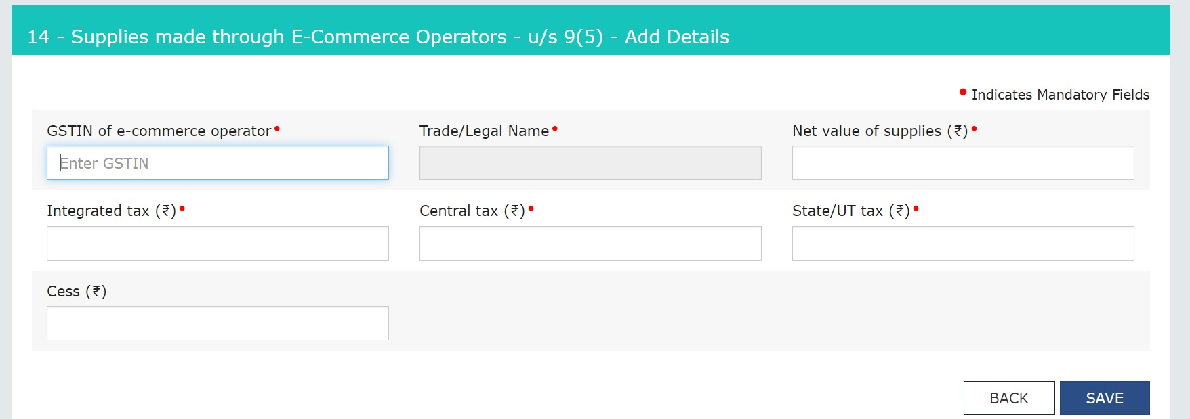
e-Commerce changes in GSTR 1/3B
Table 14 Sec. 14B Business selling services on e-commerce platforms must be updated by Supplier
Restaurant service (Swiggy / Zomato)
Passenger service (Ola / Uber)
Hospitality service (Oyo rooms / Treebo / Stayzilla / Airbnb)
Housekeeping service (Urban Company / Local Ramu)

Slide 10
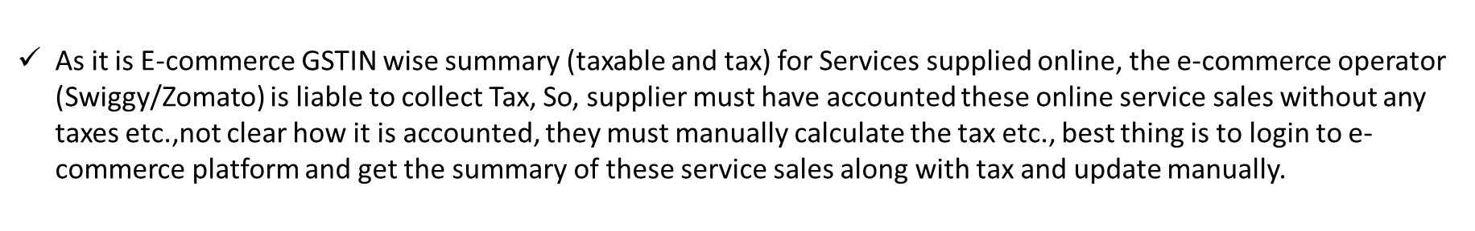
e-Commerce changes in GSTR 1/3B
Table 14 Sec. 14B Solution

Slide 11
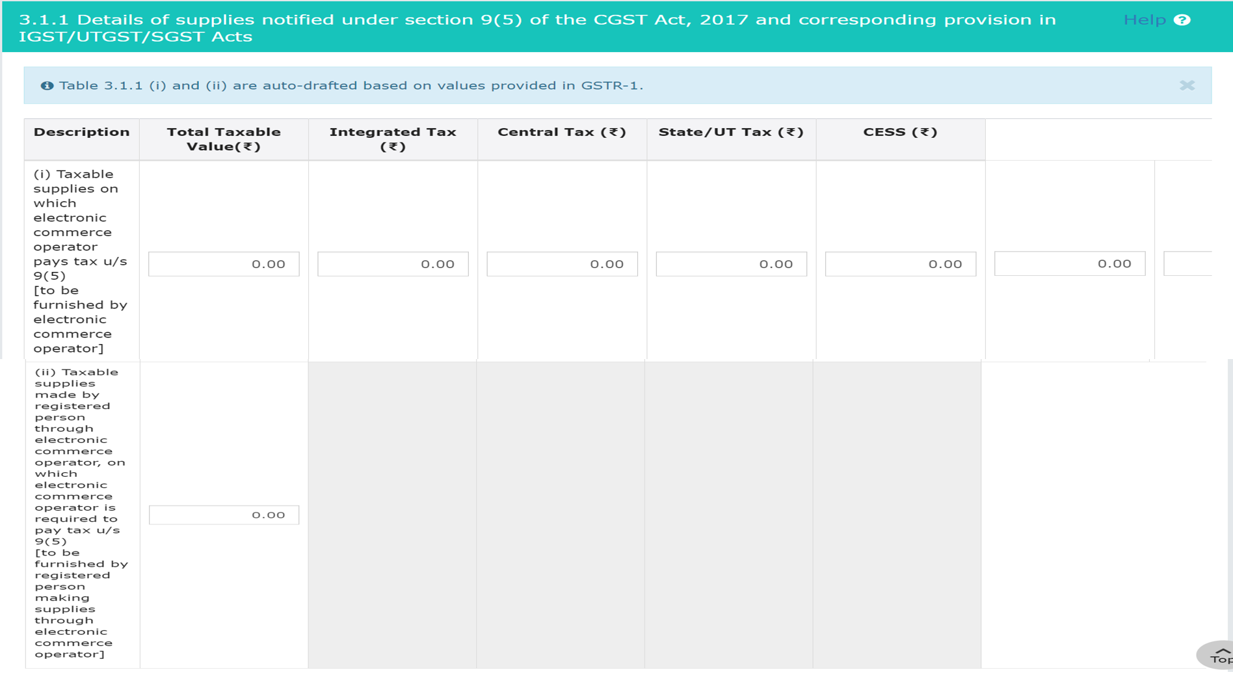
Section 14B of GSTR-1 is auto populated in GSTR-3B u/s 3.1.1(ii): Also, in GSTR2B (but no ITC)

Slide 12
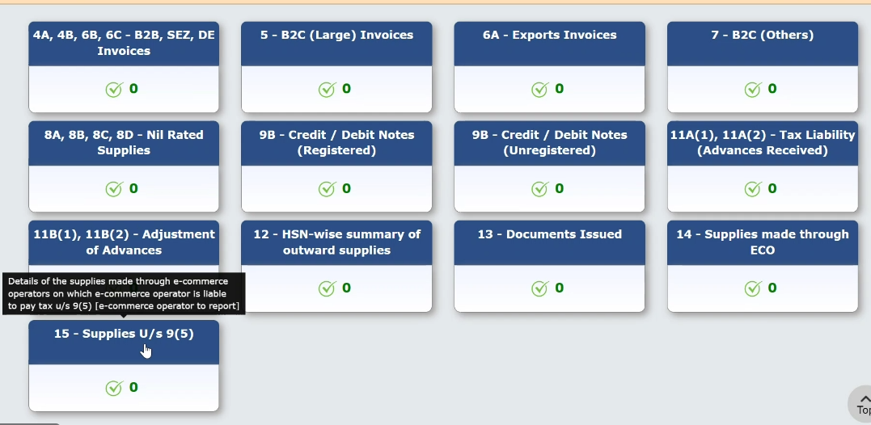
e-Commerce changes in GSTR 1/3B
GSTR-1, Table 15 Section 15A To be updated by e-commerce operations i.e., Co. itself is e-commerce operator Currently, not supported in Tally must do manually.

Slide 13
TallyPrime Release 4.1 MSME feature

Slide 14
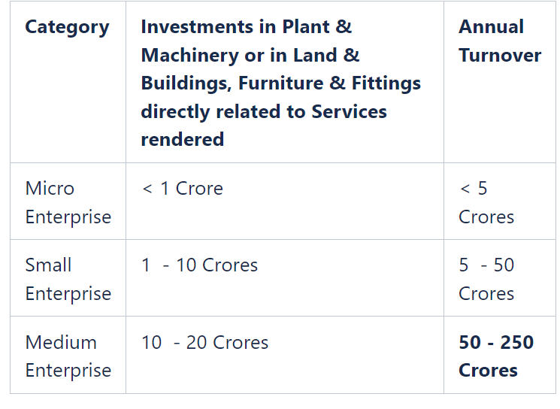
MSME feature in TallyPrime Rel. 4.1
MSME feature – Identify, Track, Pay, and Report Payments to MSME Businesses i.e., The solution of tracking pending bills ensures timely payments for both registered MSMEs and for businesses trading with MSMEs by identifying the MSME status and avoid the hassle of delayed payments.
MSME domain part in brief : All Industries engaged in Production or Manufacture of goods or rendering services are recognized as MSMEs as per below classification under the Micro, Small and Medium Enterprises Act. Development (MSMED) Act under MCA (Mistry of Corporate Affairs).
MSME registration to be done online in the government portal of udyamregistration.gov.in at no cost. Registration is not mandatory, but to avail the benefits better to register. Single entity registration irrespective of multiple branches.

Slide 15
MSME feature in TallyPrime Rel. 4.1
Benefits of being MSME registered: i.e all Micro, Small, and Medium Enterprises registered under MCA)
Bank Loans (Surety Free): Subsidy on Patent Registration:
Overdraft Interest Rate Exemption:
Industrial Promotion Subsidy Eligibility:
Fewer Electricity Bills:
ISO Certification Charges Reimbursement:
Protection against Payments (Delayed Payments): To protect MSME registered companies, Supreme Court has mandated that any buyer trading with registered MSMEs must make payment on or before the agreed date of payment or within 45 days from the date goods or services accepted/received by the buyer. (This complies as per MSME ministry)
If buyer delays the payment for more than 45 days, then buyer must pay 3 times the rate of interest on the amount due as notified by RBI. . (This is non-compliance as per MSME ministry)

Slide 16
MSME feature in TallyPrime Rel. 4.1
Few more compliance & Non-compliance as per MSME ministry
All registered MSMEs must print Udyam Registration Number on documents- It is considered advisable that the Micro and Small Enterprises Should mention/get printed on their letterhead, supply order, sheets, invoices, bills, and other relevant documents.
Compliance applicable for Companies i.e., Public or Private Company, Micro or Small Companies; trading with registered MSMEs have outstanding dues i.e. Unpaid bill to MSEs it is mandatory to disclose them in Form MSME-1 and file the same with the ROC (Registrar of Companies).
Late Filing Penalty for MSME Form 1 - Includes non-furnishing, furnishing complete/incorrect information, then penalty with a fine up to Rs.25000 (Co.,), Rs.25000/- (Min) & Rs.3 lacs (max) with imprisonment of 6 months for directors or both. Therefore, it is mandatory for directors to file the MSME form 1.

Slide 17
MSME feature in TallyPrime Rel. 4.1
Few more compliance & Non-compliance as per MSME ministry
Interest charged on delayed payments - The penal interest chargeable for delayed payment to an MSME enterprise is three times of the bank rate notified by the Reserve Bank of India.
MSME SAMADHAAN-Delayed Payment Monitoring System- MSME Samadhaan is a Portal created by Office of DC(MSME), Ministry of Micro, Small and Medium Enterprises (MSME) where Micro and Small Enterprises (MSEs) can file their applications online regarding delayed payments.
Unpaid bills by due date nor paid within financial year ending will be disallowed under section 43b(h) of income tax act i.e., cannot claim these expenses as deductions as its not cleared so pay Income Tax. However, any due amount to MSMEs if paid by within the F/y end can claim as deduction in the same year.

Slide 18
MSME feature in TallyPrime Rel. 4.1(Refer demo data or create one)
For Registered MSMEs: (All Micro, Small, and Medium Enterprises registered under MCA) Considering Receivables at a high level
Set up MSME registration details' UDYAM Registration No. Enterprise Type & allowed credit days as per MCA as per applicable dates.
Print invoices and reports with your Udyam Registration Number, indicating your MSME status to buyers for timely payment and better business engagement
A quick filter to identify due or delayed receivables, allowing MSMEs to take prompt action.
Send timely reminder letters, encouraging prompt payments and develop stronger business relationships for MSMEs.

Slide 19
MSME feature in TallyPrime Rel. 4.1 (Refer demo data or create one)
For Businesses (i.e all specified Companies, public or private trading/taking services/supplies) from MSEs)
Setup the MSME status of your suppliers, for prompt & timely payments
Quick filters for outstanding payables to MSEs to track and clear payments on time to avoid any additional costs of interest payable due to late payments.
Quick access to overdue bills (unpaid to MSME enterprises as on deadline 45 days credit) and report them in MSME Form 1 to ROC (Registrar of Companies).
Quick access to the list unpaid bills by due date and not paid within financial year ending will be disallowed under section 43b(h) of income tax act i.e., cannot claim these expenses as deductions as its not cleared so pay Income Tax. However, any due amount to MSMEs if paid by within the F/y end can claim as deduction in the same year. (W.r.t Co’s ITR must do offline not supported in Tally)

